Slide 2
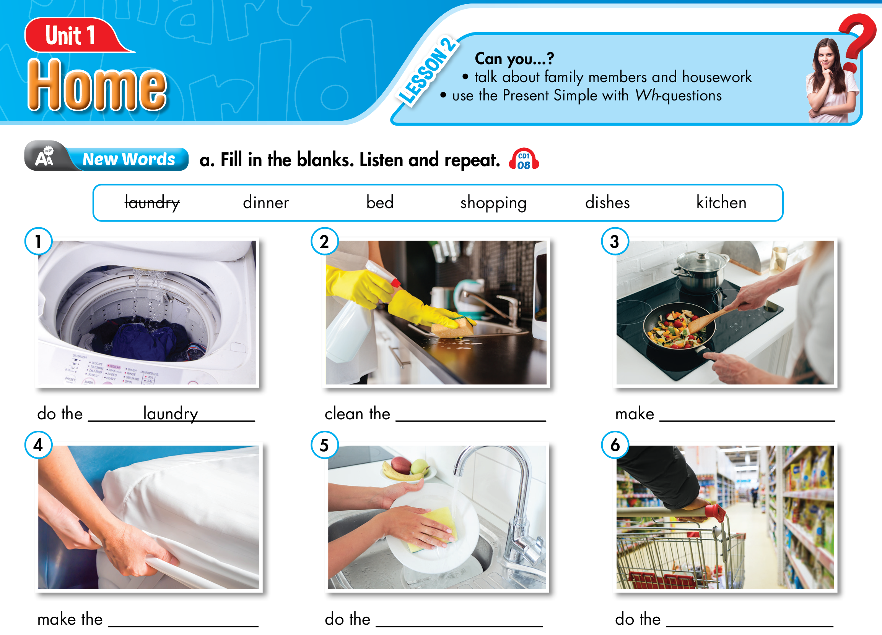
Lesson 2
kitchen
dinner
bed
dishes
shopping

Slide 3
Wednesday, September 15th, 2021
UNIT 1: HOME
Lesson 2
I. Vocabulary
do the laundry
clean the kitchen
make dinner
make the bed
do the dishes
do the shopping = go shopping
: giặt đồ
: dọn bếp
: nấu bữa tối
: dọn giường
: rửa chén
: mua sắm

Slide 4
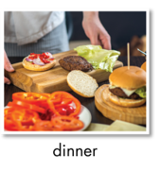
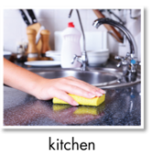
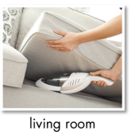
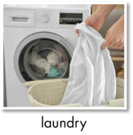
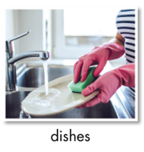
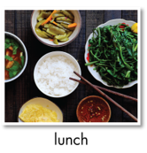
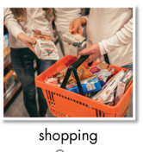
Lesson 2
make dinner
clean the kitchen
make breakfast
clean the living room
do the laundry
do the dishes
make lunch
do the shopping

Slide 5
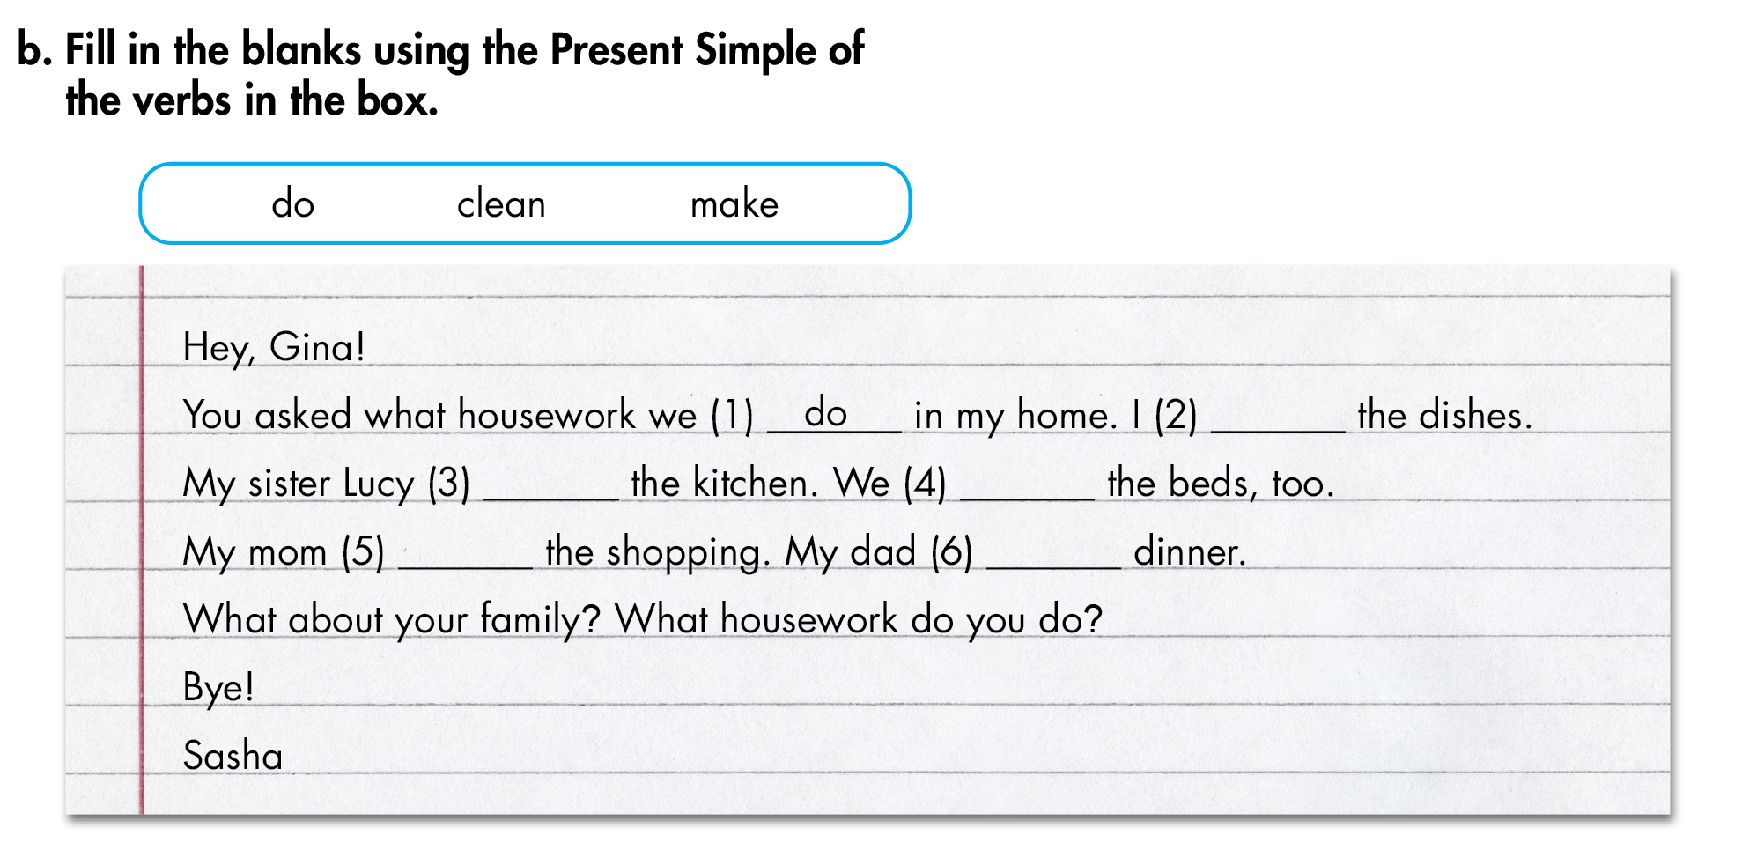
Lesson 2
b/ trang 10
do
cleans
make
does
makes

Slide 6
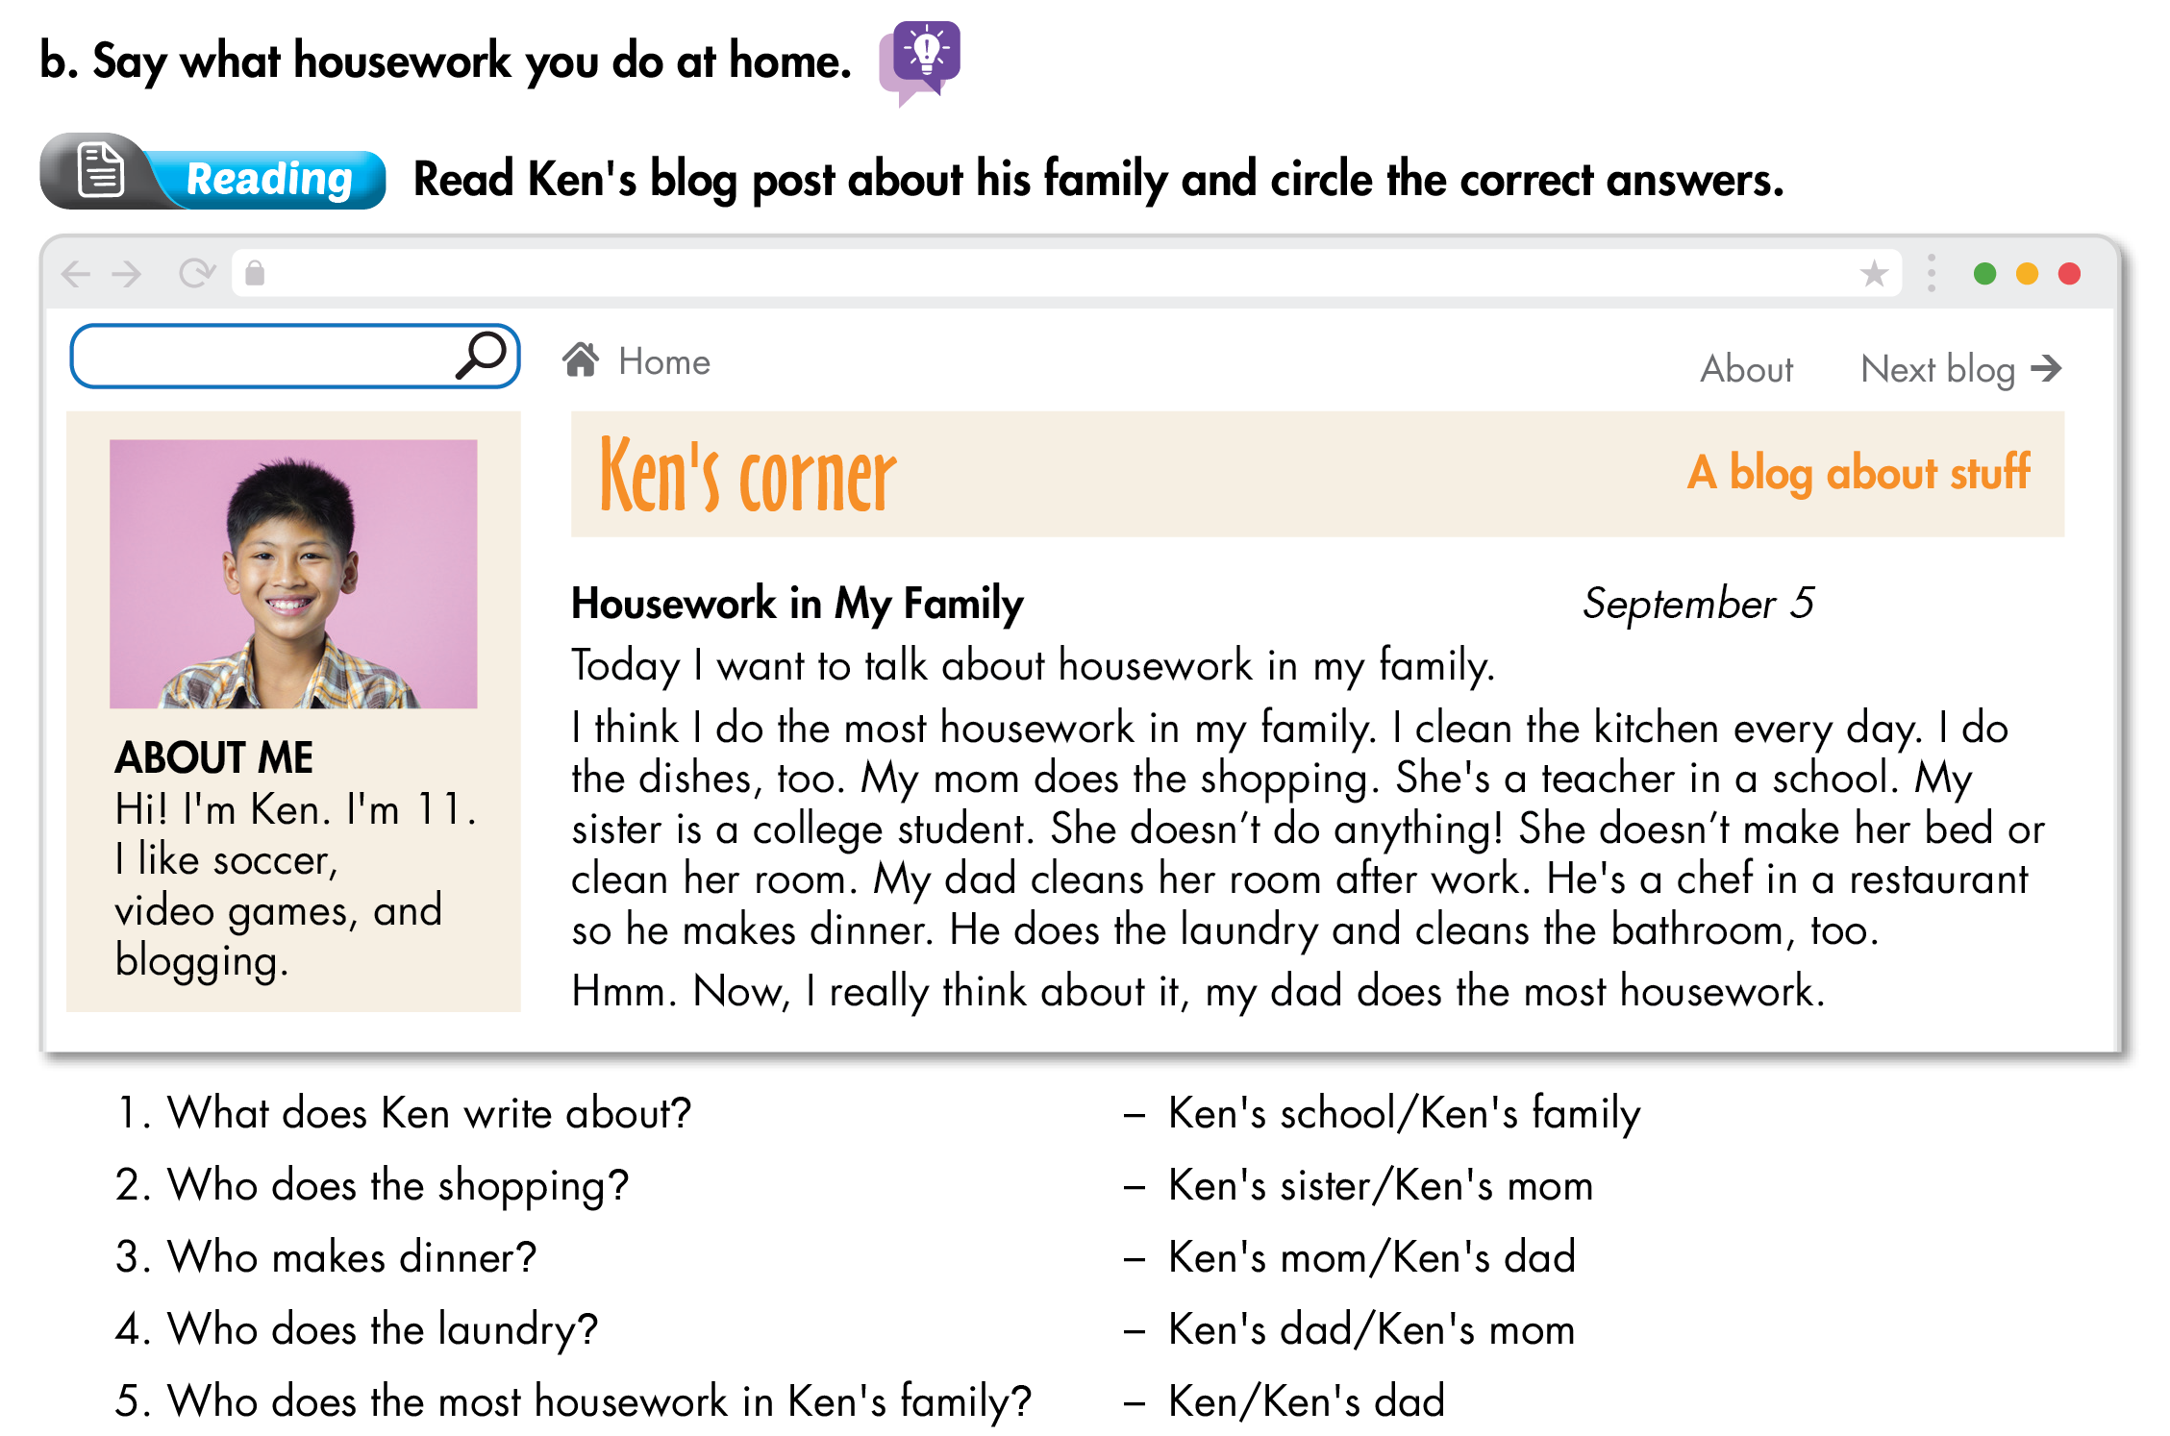
Lesson 2

Slide 7
II. Grammar:
1. The Present Simple with Wh-questions
Wh-questions: What, Where, When, Why, Who, Which, Whose, How, …
do + you / we / they + V ?
does + he / she / it + V ?
Wh-questions +
Ex: Where do you live?
Ex: Where does she live?
I live in HCM City.
She lives in Hanoi.
* Note:
Who + V/V_{s/es} + O?
Ex: Who cleans the kitchen?
My mom cleans the kitchen.
My mom does.
My mom.
Ex: Who does the laundry?
I do the laundry.
I do.

Slide 8
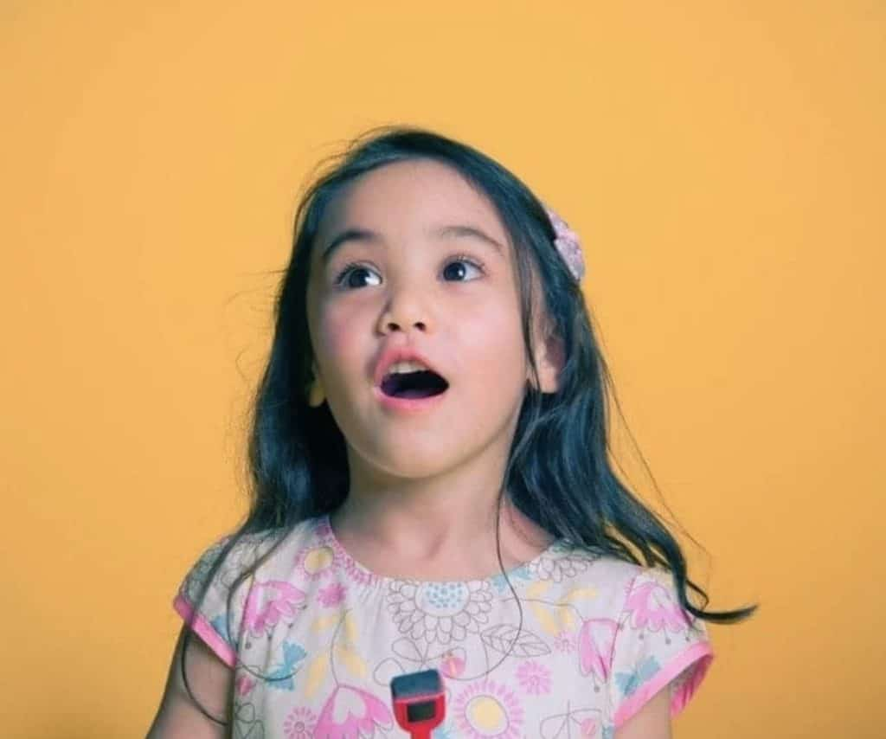
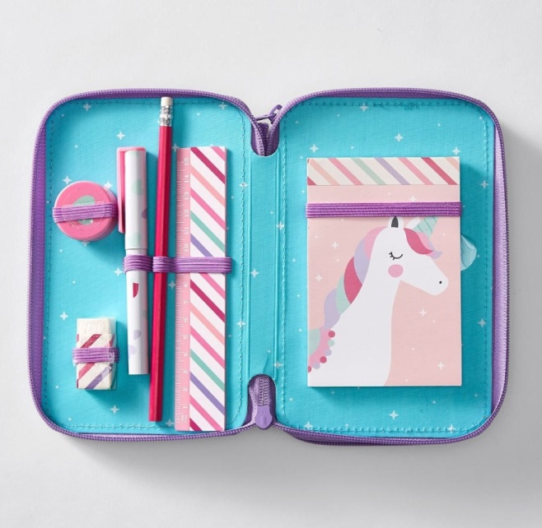
II. Grammar:
2. Possessive ’s: từ sở hữu
This is Lucy.
This is Lucy’s pencil case.
This is her pencil case.
Name’s + noun

Slide 9
ruler
eraser
This is Lucy’s ruler.
They are Lucy’s erasers.

Slide 10
II. Grammar:
2. Possessive ’s: từ sở hữu
Name’s + noun
This is Lucy’s ruler.
They are Lucy’s erasers.
She is Tom’s mom.
He is Mary’s brother.

Slide 11
Lesson 2

Slide 12
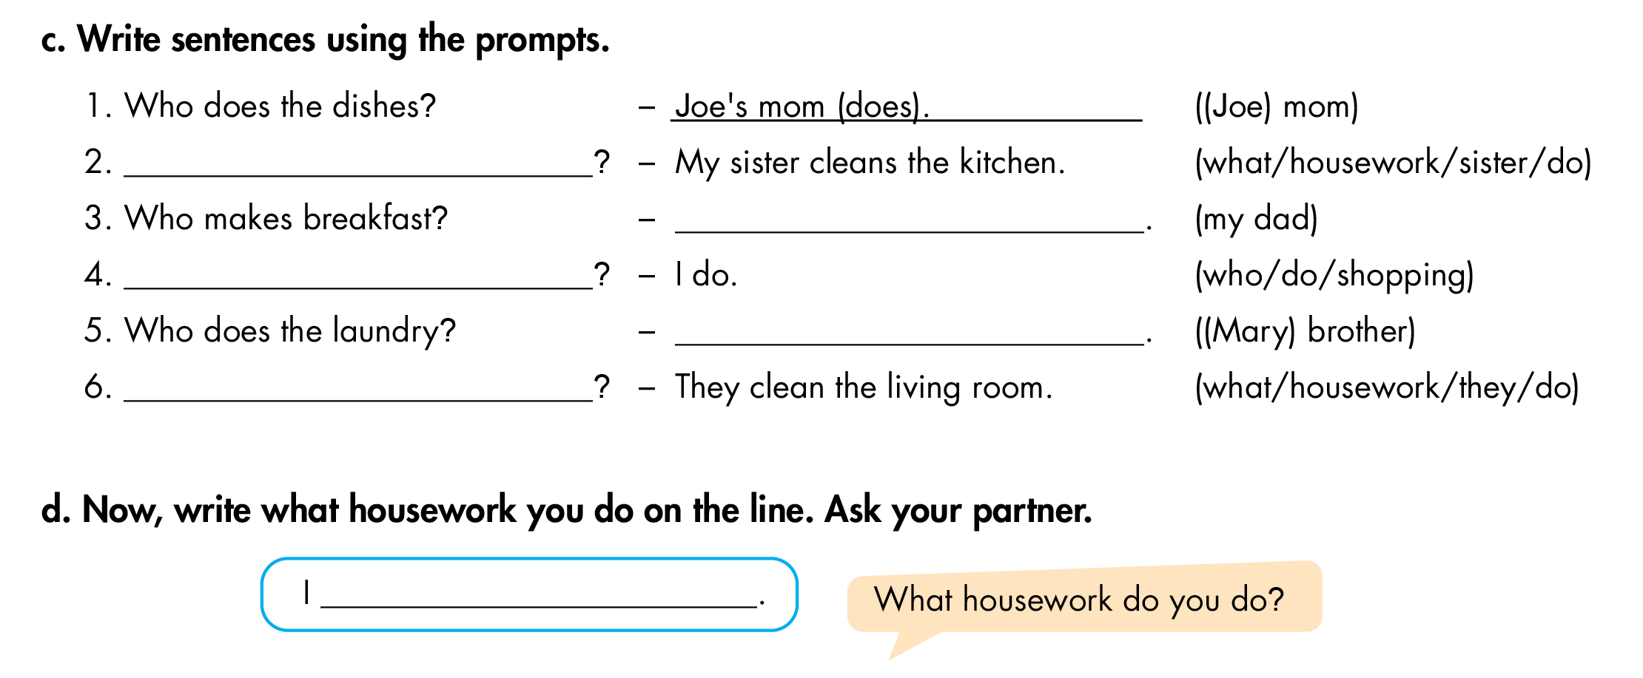
Lesson 2
c/ trang 10
What housework does your sister do
My dad (does)
Who does the shopping
Mary’s brother (does)
What housework do they do

Slide 13
Lesson 2

Slide 14
Lesson 2

Slide 15
HOMEWORK
1. Học thuộc Vocabulary và Grammar.
2. Làm bài tập A, B, C

Slide 16
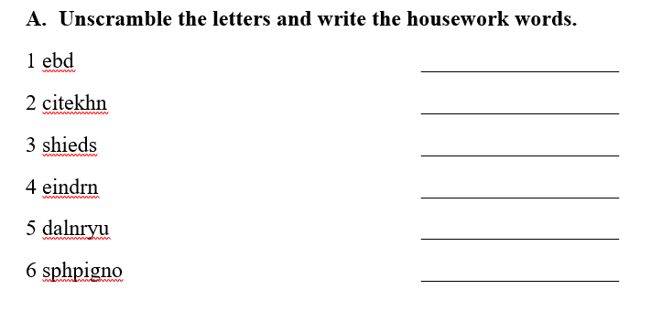
bed

Slide 17
A
B
C
laundry
→ C
D
E
F

Slide 18
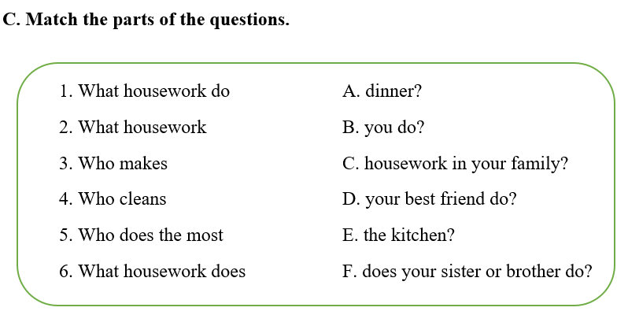
1-B. What housework do you do?
2-

